Slide 1
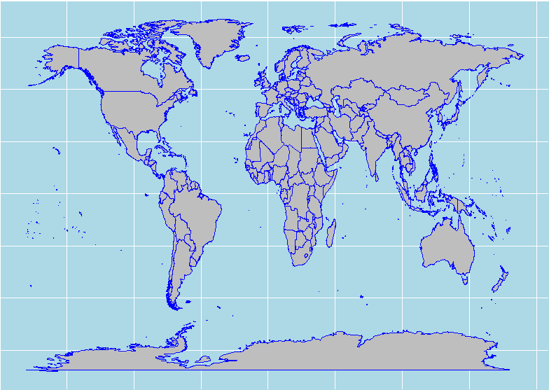


NATASHA SING
Notes:
Good morning, my presentation is based on Geo-spatial data visualization. The map we see above is one that I have built manually using ggplot

Slide 2


Notes:
Does anyone know the difference between Trump and an eggplant? Lets keep that question open for just a little while.

Slide 3
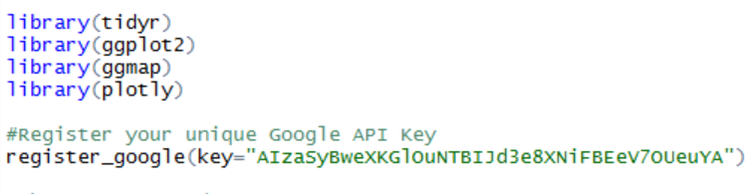
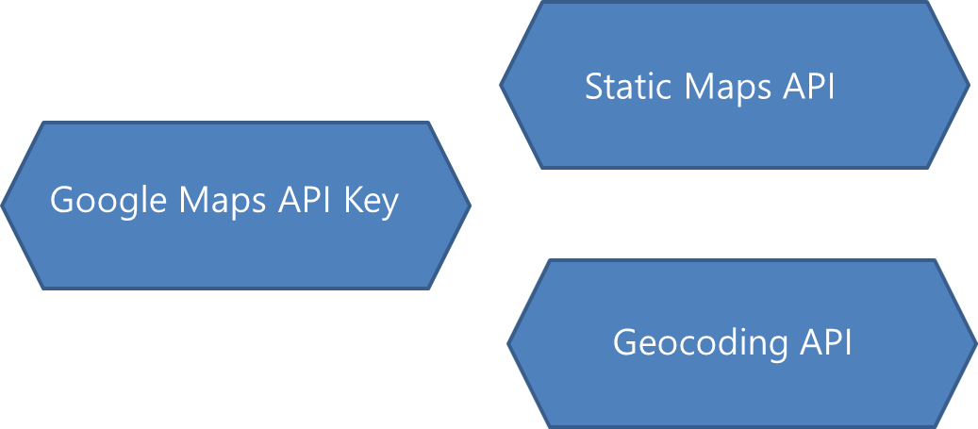
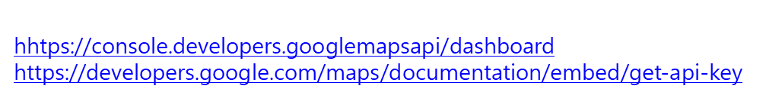
Exploring the interest of veganism
GGMAP + GGPLOT2 = Powerful Combination
Notes:
Today we explore the interest of veganism building our own maps in R. The ggmap and ggplot2 libraries provides a powerful combination to retrieve and plot any location.The ggmap library is a collection of functions to visualize spatial data and models on top of static maps from various online sources (e.g Google Maps, Stamen Maps,Open source maps). We can than plot a map as a background of a ggplot graph. To access all the functionality of ggmap , we need to create a google api key to enable Static Maps API and the Geocoding API to retrieve maps and geocodes.

Slide 4
Plotting a map with library GGMAP
The Process
Retrieve a Static Map
get_map()
Plot the map
ggmap() + ggplot2
geocode()
get_map()
qmap()
get_googlemap()
ggmap()

Slide 5
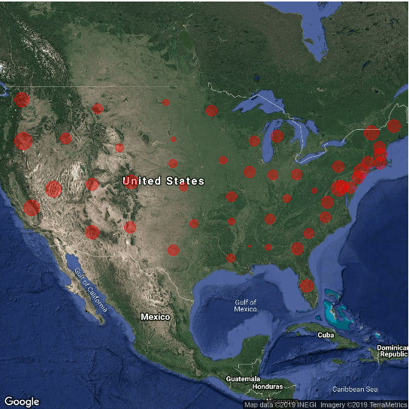
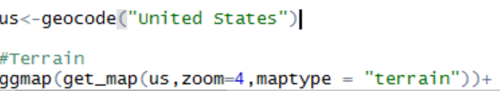
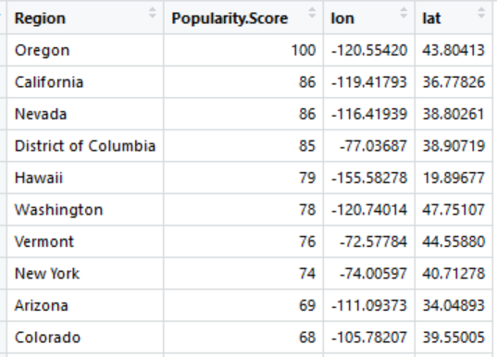
Notes:
These background plots are ideal for points but if we would like a fill view on the USA, then there is another alternative, GGPLOT2.

Slide 6
Plotting a map with library GGPLOT2
map_data() - defines boundaries of countries, states and cities
geom_polygon () – plot the geometries of the borders
Color each polygon with a fill
The Process
Retrieve a Map
map_data()
Plot the map
ggplot2

Slide 7
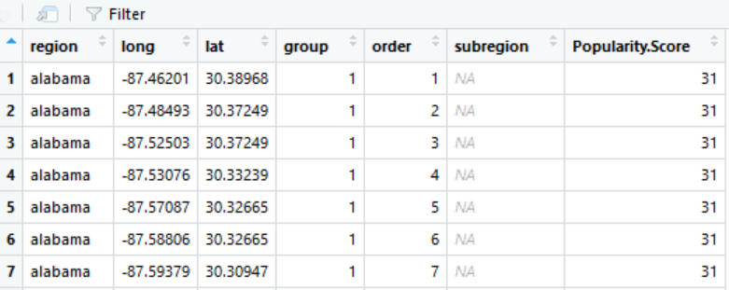
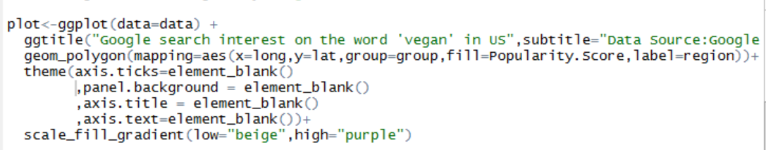
Creating a Chloropleth map using GGPLOT2
Merged data
Notes:
Using ggplot we can plot each region as a polygon with its own boundaries and create a fill for each region.

Slide 8
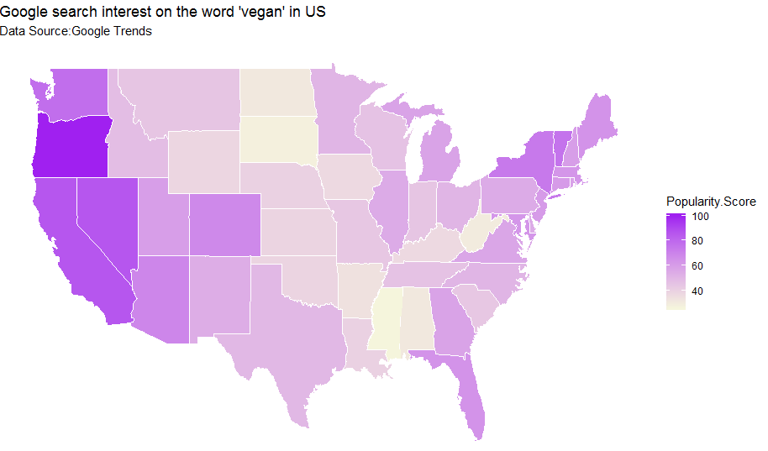
Notes:
This map shows us the highest search interest is in the west pacific coast. Ideally I would like to see the name of the regions

Slide 9
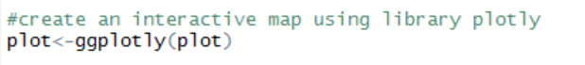
Creating a Chloropleth map using GGPLOT2
Creating an interactive plot
http://rpubs.com/natashasing/482496
Notes:
Using the library plotly, which we can create an interactive map which we can be published in html

Slide 10
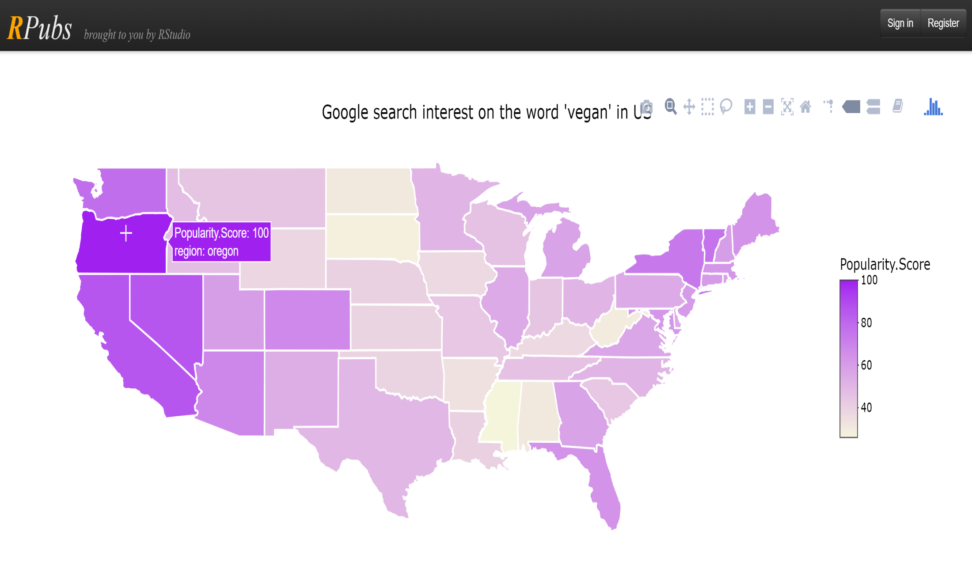
Notes:
Using the library plotly, which we can create an interactive map which we can be published in html

Slide 11
Notes:
Does anyone know the difference between Trump and an eggplant? Lets keep that question open for just a little while.

Slide 12
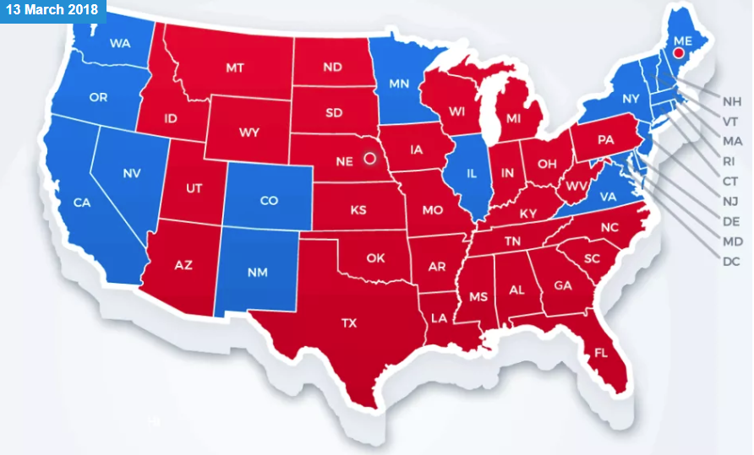
Notes:
The next map shows us the democratic and republic states, there is a high positive correlation between search interest of vegans and these blue states above

Slide 13



Slide 14


Trump
Pumpkin
Notes:
The only difference is that people with high search interest in veganism (democratics) will vote for eggplant and not Trump!!

Slide 15

Notes:
And there will definitely be a rise of the vegan☺

